Slide 1

Library & Event Booking System
CS-GY 6083 – Principles of Database Systems Project Part II
(Spring 2025)
Team: Siddharthan P S (sp8004), Zexi Peng (zp2277)

Slide 2

Executive Summary
Project Continuation
Extending schema design to full-stack app
User Roles
Customers and employees manage library tasks
Tech Stack
React frontend, Flask + SQLite backend

Slide 3
System Features Overview
Customer Features
Employee Features
Book rentals and event participation
Add, edit, delete books
View invoices and payment logs
Manage clients, rentals, invoices
Handle events and sessions

Slide 4
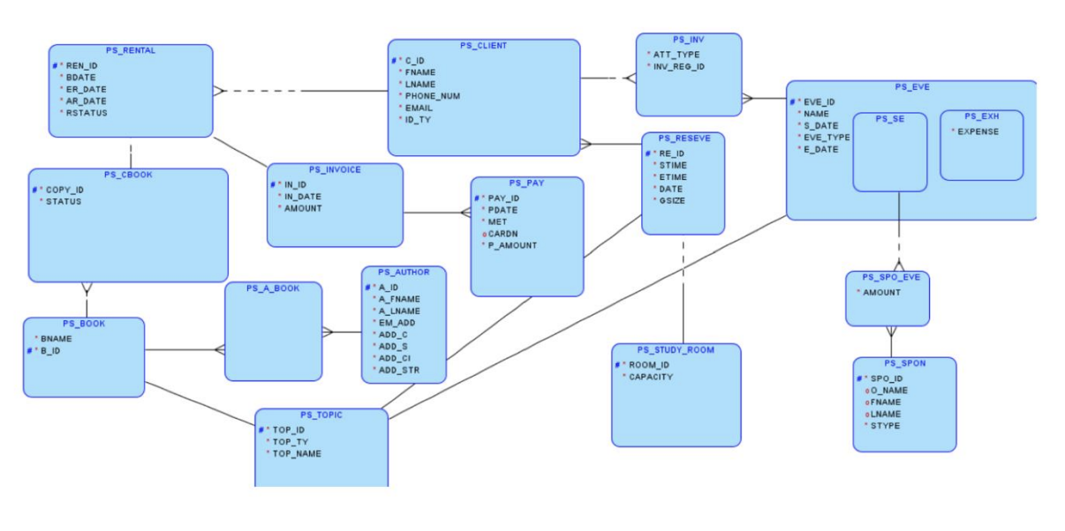
Logical Database:

Slide 5
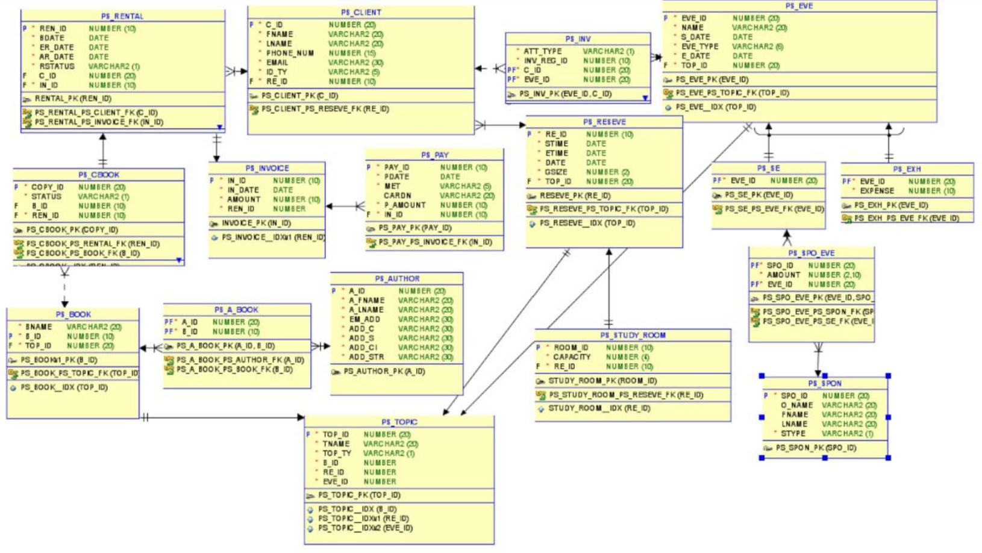
Relational Database:

Slide 6
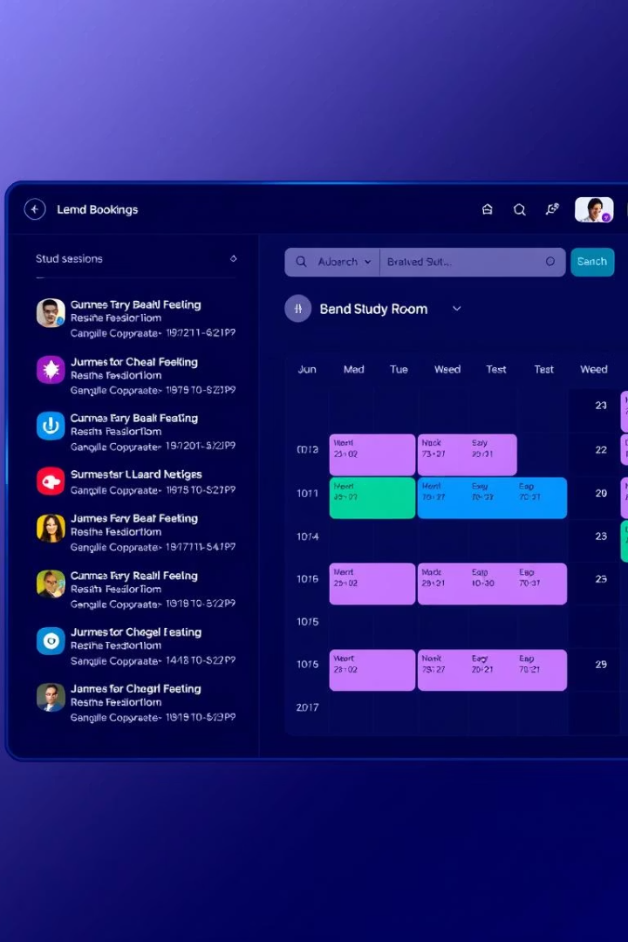
System Features
Role-Based Login
Admin and customer authentication
Dynamic SPA
Built with React
Resource Rentals
Books and study rooms management
Event Management
Sponsors, sessions, and expenses tracking

Slide 7
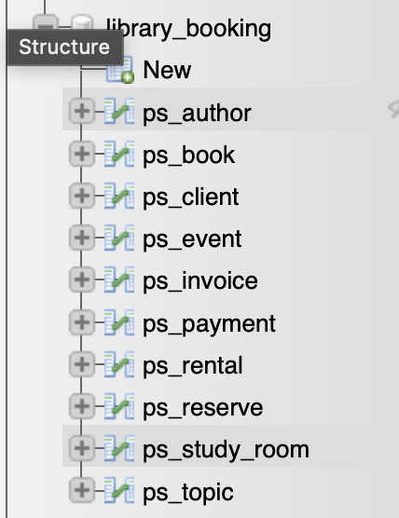
Database Design Highlights
Core Entity
Key Tables
Features
PL_CLIENT
PL_BOOK
Normalized tables
PL_RENTAL
Foreign key constraints
PL_EVENT
Many-to-many and one-to-many
PL_INVOICE
PL_STUDY_ROOM

Slide 8
Project Assumptions
Email Uniqueness
Book Types
One email per client
Supports digital booking and physical pickup
Inventory Link
Room Reservations
Books tied to events
Includes study room booking

Slide 9
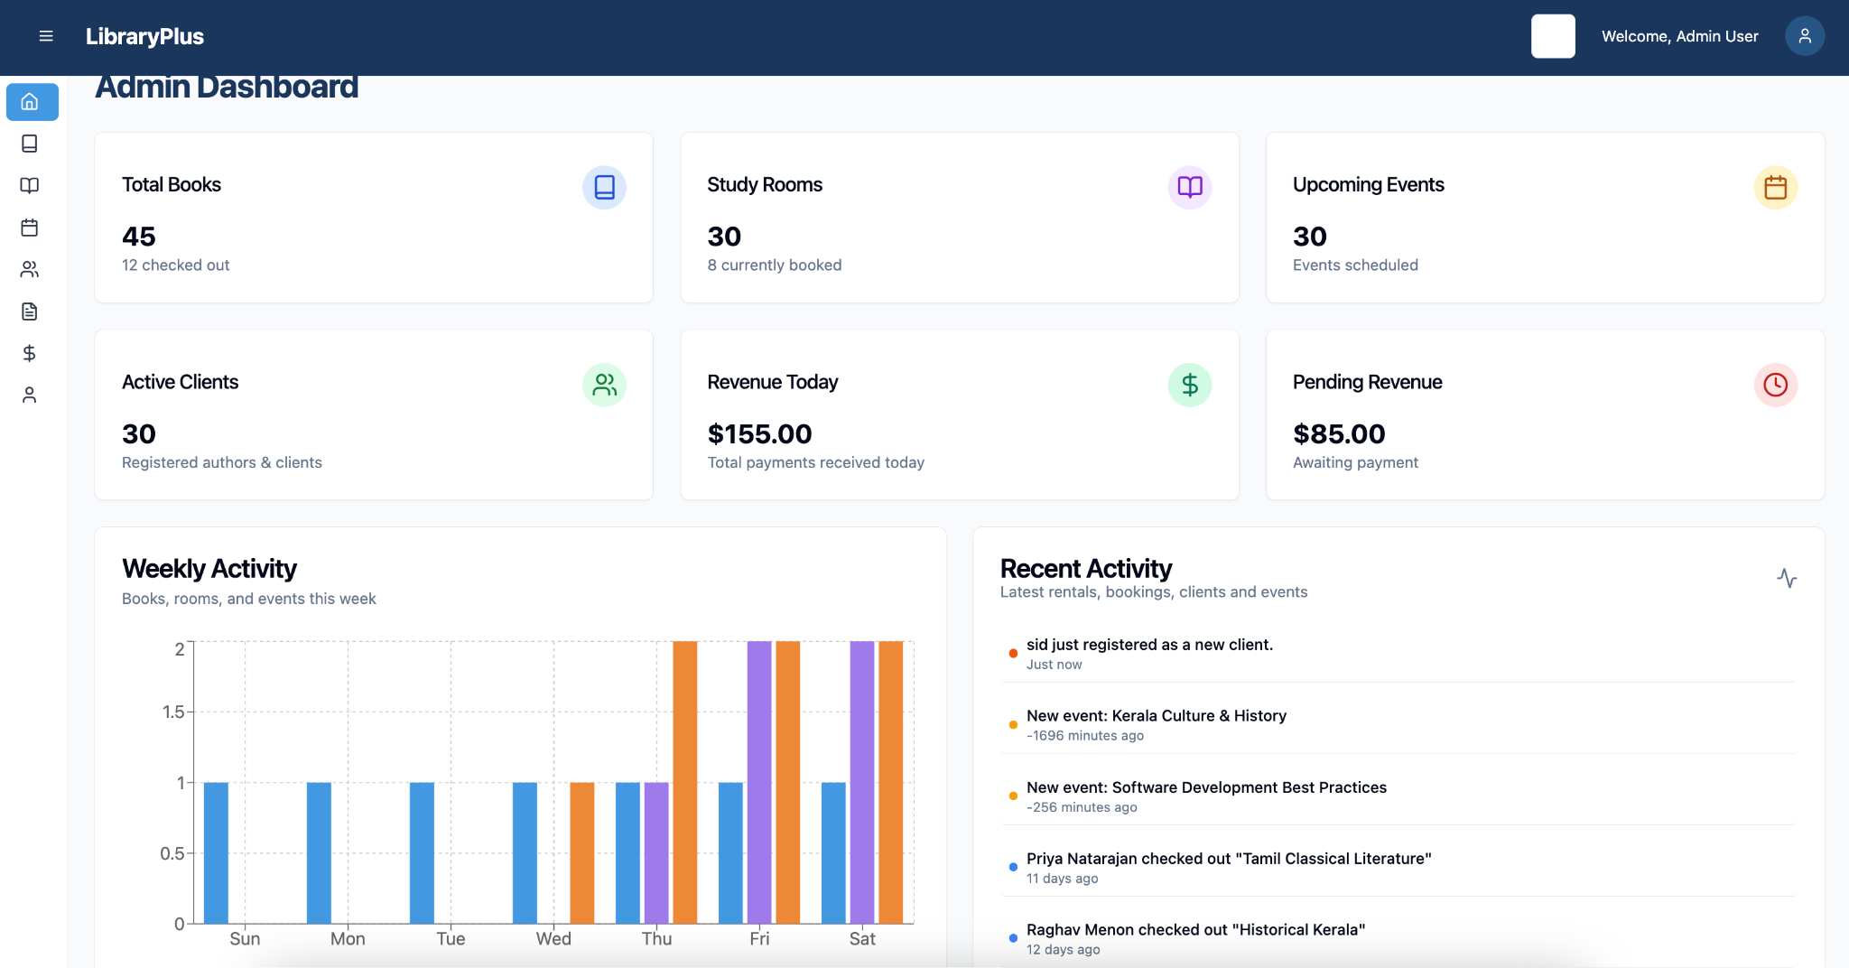
Technical Stack
Frontend
ReactJS with Context API
React Router DOM
Chart.js / Recharts for graphs
JSX with HTML5 & CSS3
Backend
MySQL managed via phpMyAdmin
SQL with SELECT, JOIN, INSERT, UPDATE
Data integrity with constraints

Slide 10
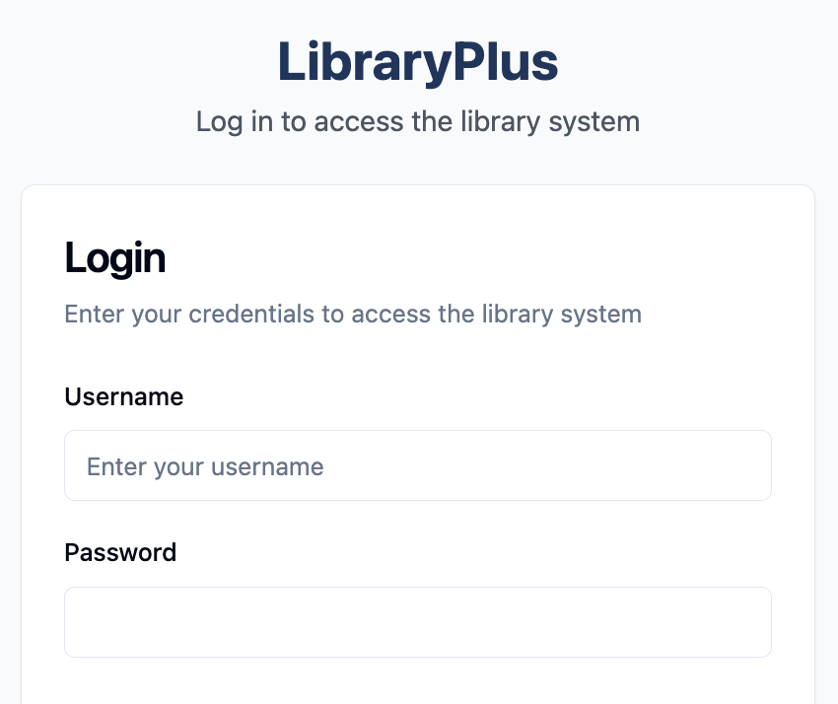



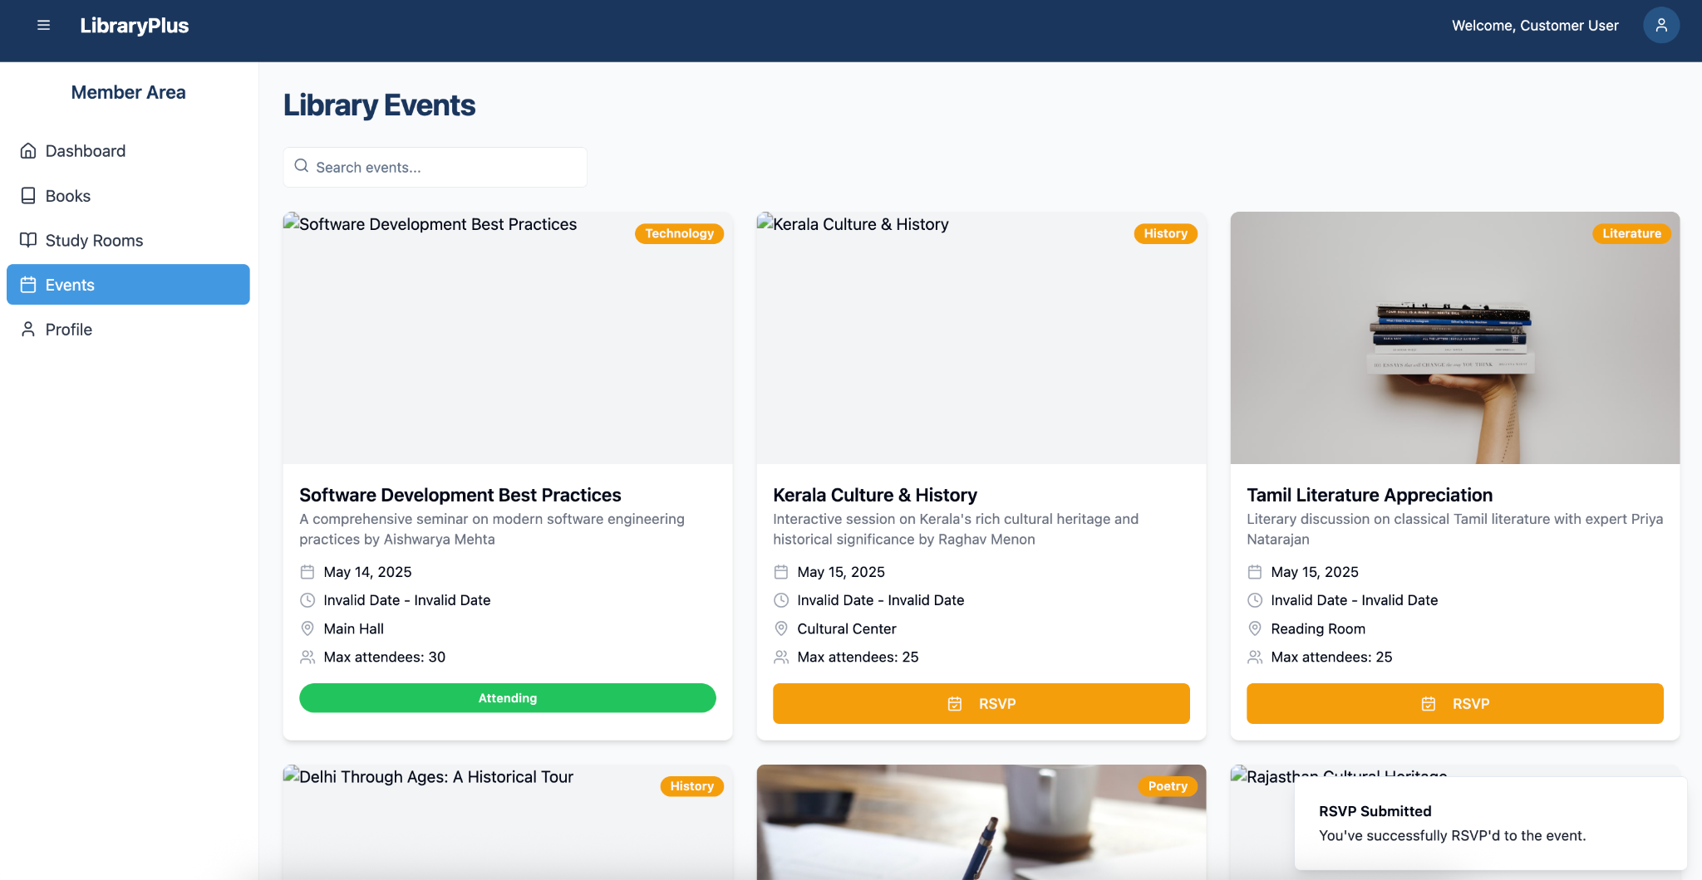


System Design Overview
Authentication
Login with session stored in localStorage
Authorization
Role-based UI and routing
Dashboard Graphs
Dynamic charts per user role
Session Handling
Persistent across page refresh
UI/UX
Responsive with validation

Slide 11
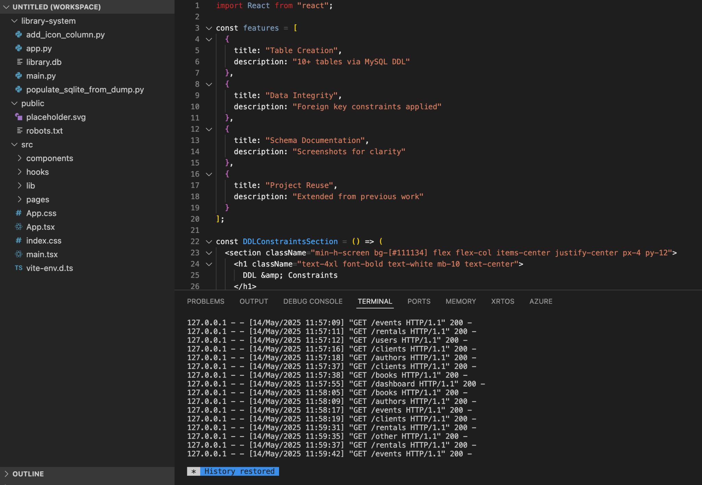
DDL & Constraints
Table Creation
10+ tables via MySQL DDL
Data Integrity
Foreign key constraints applied
Schema Documentation
Screenshots for clarity
Project Reuse
Extended from previous work

Slide 12





Application Implementation
Admin Dashboard
Book Management
Invoice Creation
Study Room Reservations
Event Management

Slide 13
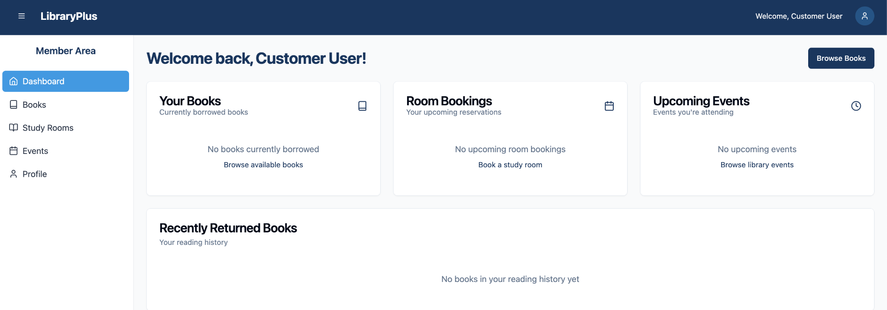
Application Implementation
Admin Dashboard Client

Slide 14
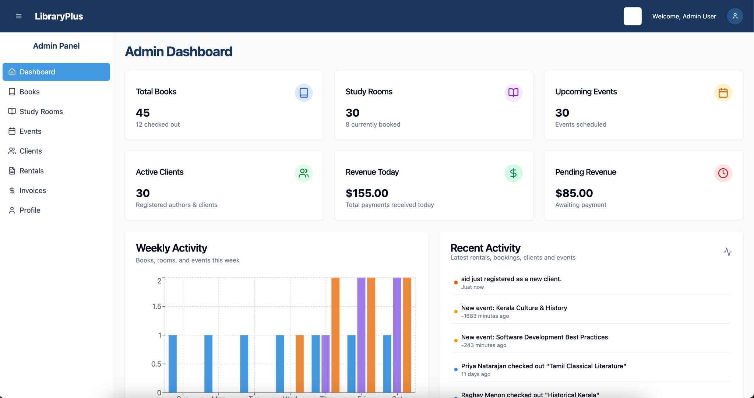
Application Implementation
Admin Dashboard Admin

Slide 15
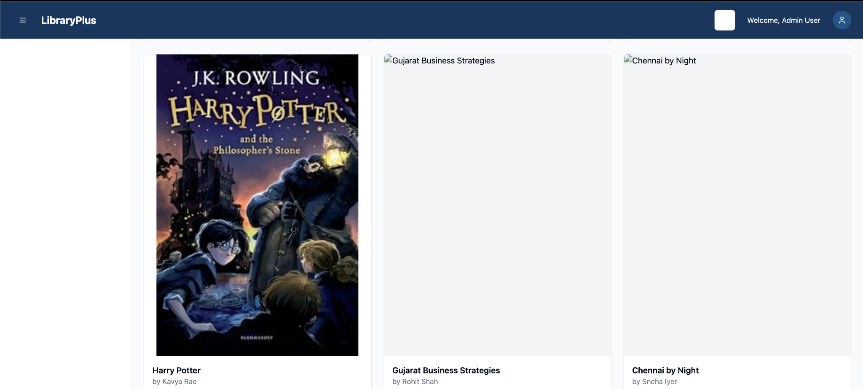
Application Implementation
Book Management

Slide 16
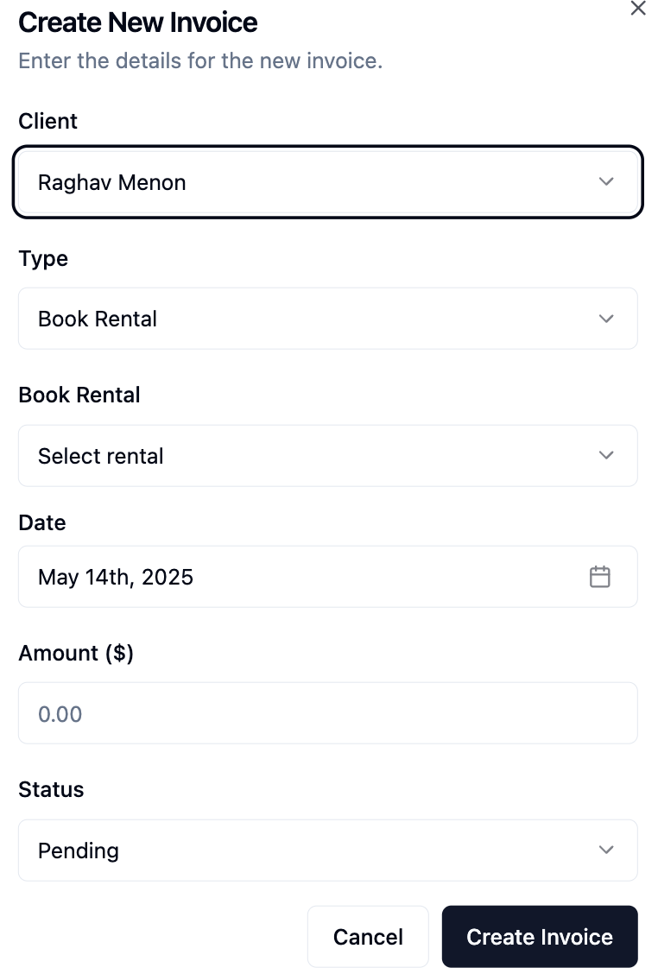
Application Implementation
Invoice Creation

Slide 17
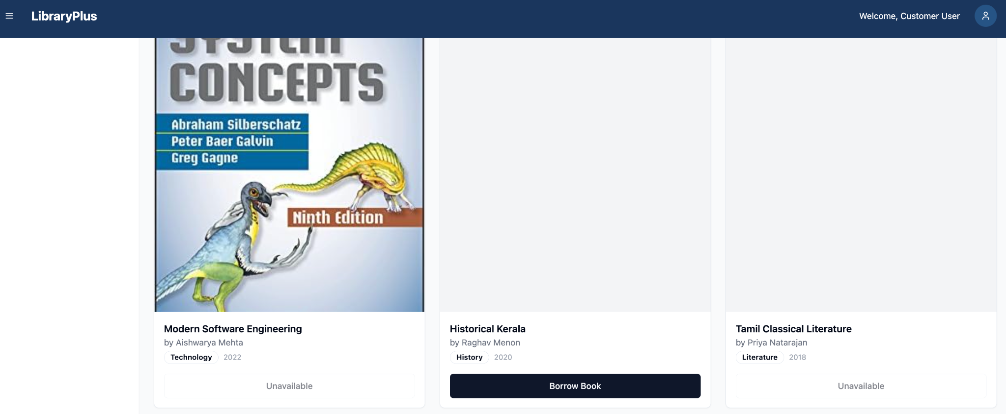
Application Implementation
Study Room Reservations from client

Slide 18
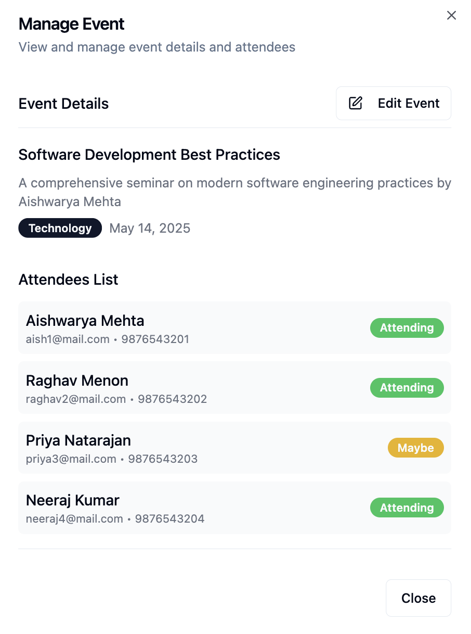
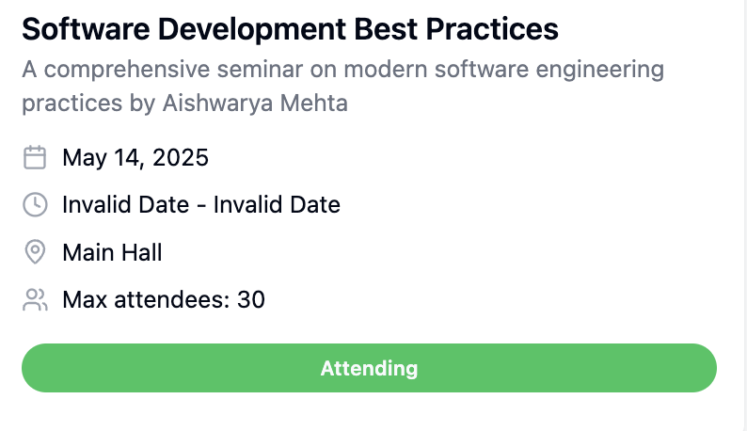
Application Implementation
Event Management

Slide 19
Security Features
React Context
Role-Based Rendering
Protected Routes
Manages authentication state
UI adapts per user role
Prevents unauthorized access
Client Validation
Redirects
Required fields and password checks
Unauthorized users sent to login

Slide 20
Key SQL Queries
JOIN Query
Subquery
Correlated Subquery
SET Operator
Clients, Rentals, and Books
Clients with pending rentals
Rental count per client
Renters and reservers union
WITH Clause
Top-N Query
Rental count with JOIN
Top 3 events by expense

Slide 21
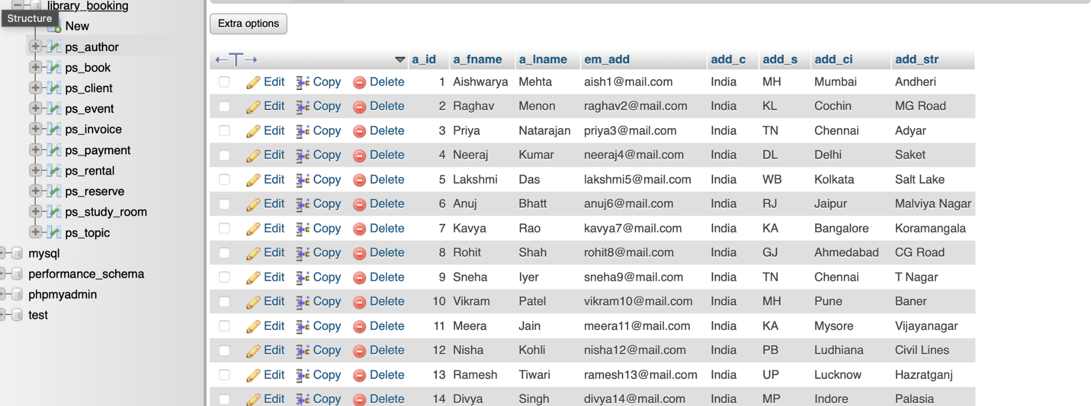
Author Table Overview

Slide 22
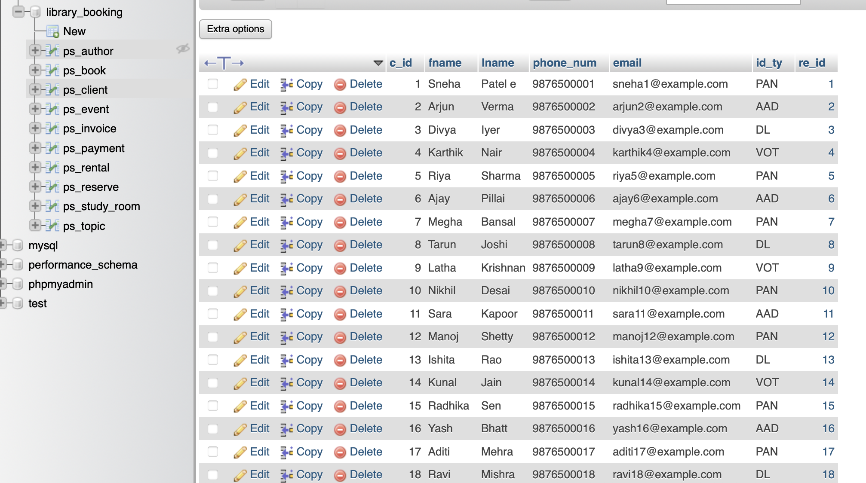
Client Table Overview

Slide 23
Client Table Overview

Slide 24
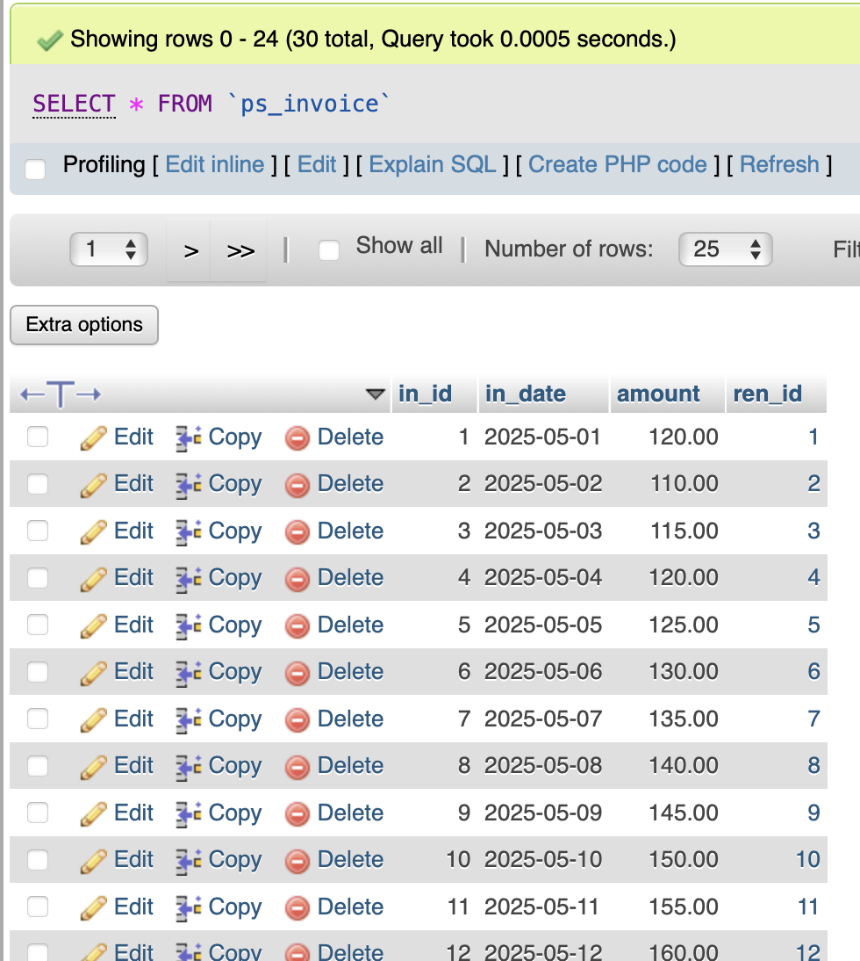
Invoice Overview

Slide 25
Thank you!

